Slide 1
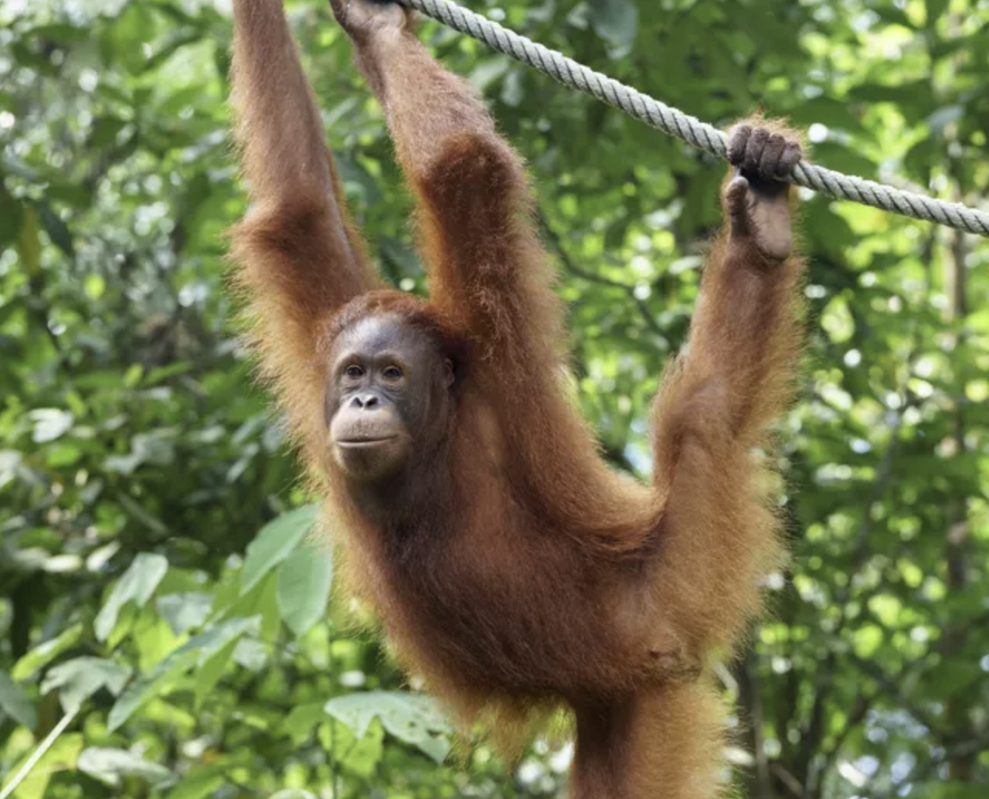
Orangutan
Perry
HPCX73601

Slide 2
Introduction
· SPECIFIC INFORMATION
· HABITAT & DIET
· SOCIAL BEHAVIOR
· PROTECTION MEASURES

Slide 3
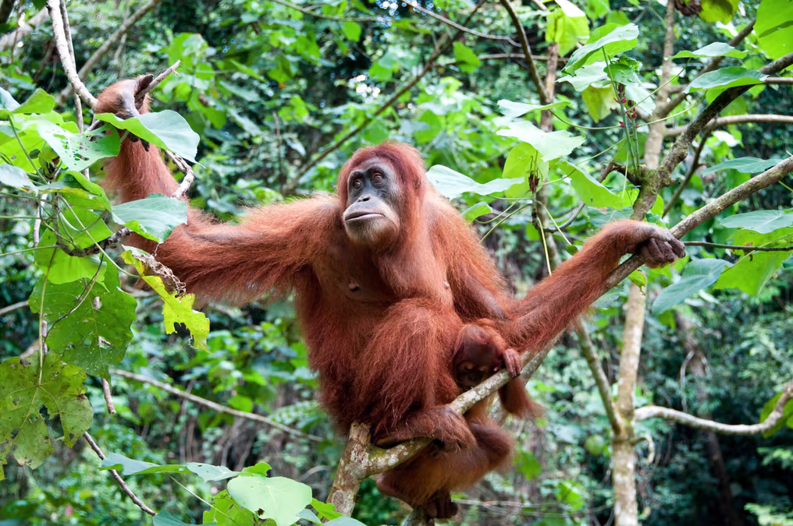
Secific Information
· The largest arboreal mammal
· They have larger cerebellums than humans
· No tail
· Strong arms and legs
· Powerful jaws

Slide 4
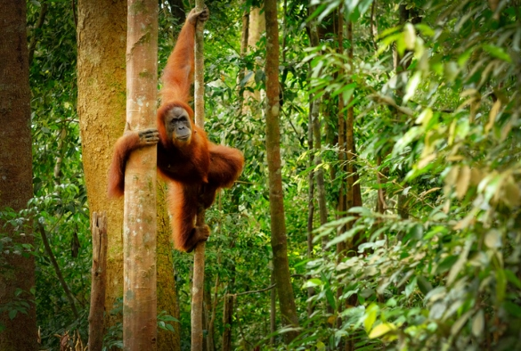
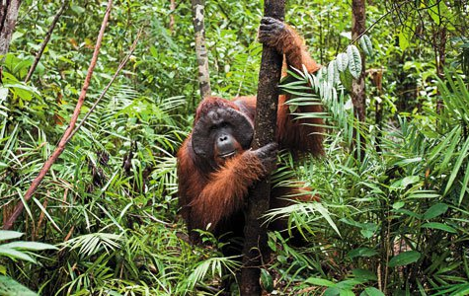
Habitat
Rain forests of the Southeast Asian islands of Borneo and Sumatra

Slide 5
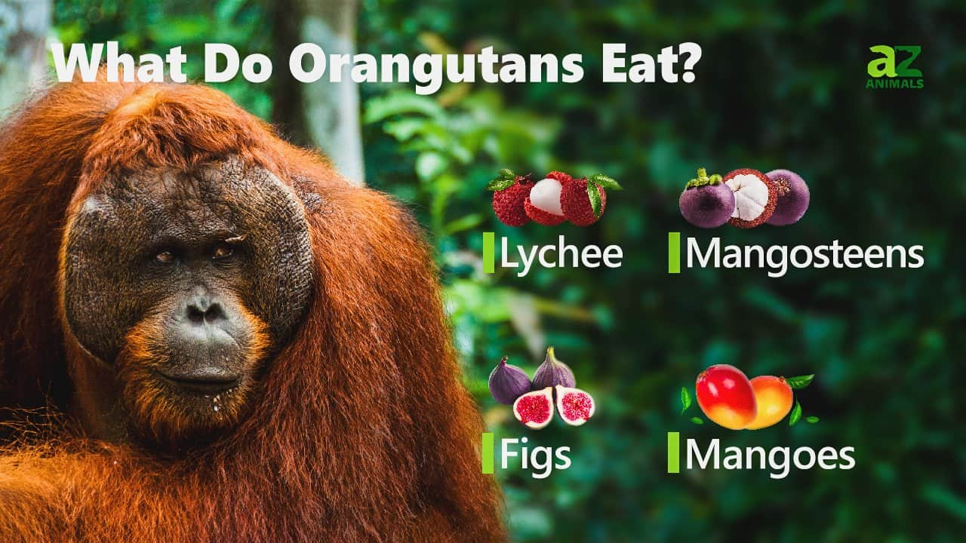
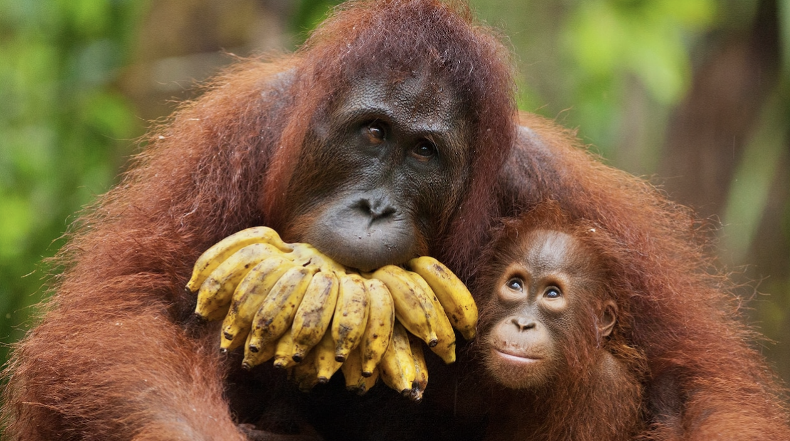
Diet
Most of orangutans’ diet is composed of fruit. And they eat more than 400 different plant varieties. Orangutans spend up to six hours a day eating or foraging for food.

Slide 6
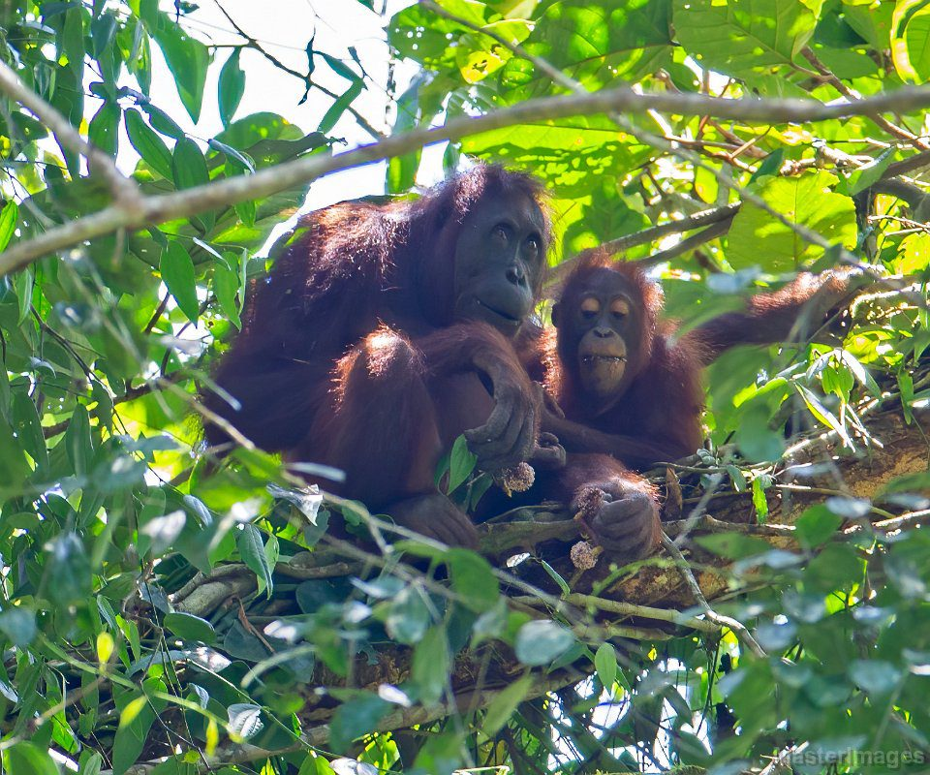
Social behavior
· Orangutans are semi-solitary species but remain, to some degree, somewhat social.
· Male-male competition for access to sexually receptive females is a major factor in orangutan adaptation.
· Almost every night orangutans construct a new sleeping nest from branches, usually 15 to 100 feet up in a tree.
· Orangutans have high cognitive abilities.

Slide 7
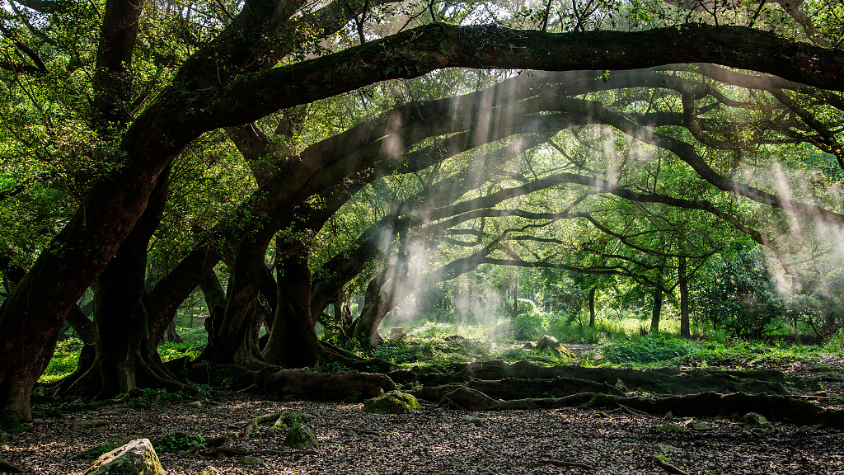
Protection measures
How people make contribution to protect the orangutan?
· Appeal to everyone to reduce the cutting down of trees
· Put up posters to campaign for protection of orangutans
How government protect the orangutan?
· Set up a organization to protect the orangutan
· Expand the area planted with trees

Slide 8
References
“Orangutan”. WWF.
https://www.worldwildlife.org/species/orangutan
[Accessed June 6, 2022].
“Physical characteristics of orangutan”. SEAWORLD PARKS & ENTERTAINMENT.
https://seaworld.org/animals/all-about/orangutans/characteristics/
[Accessed June 6, 2022].
“Orangutan Behavior”. ORANGUTAN.
https://orangutan.org/orangutan-facts/orangutan-behavior/
[Accessed June 6, 2022].

